Slide 1

JBPM Process Management
By : Sachin Chopra
Summer Intern (CCSM2T)

Slide 2
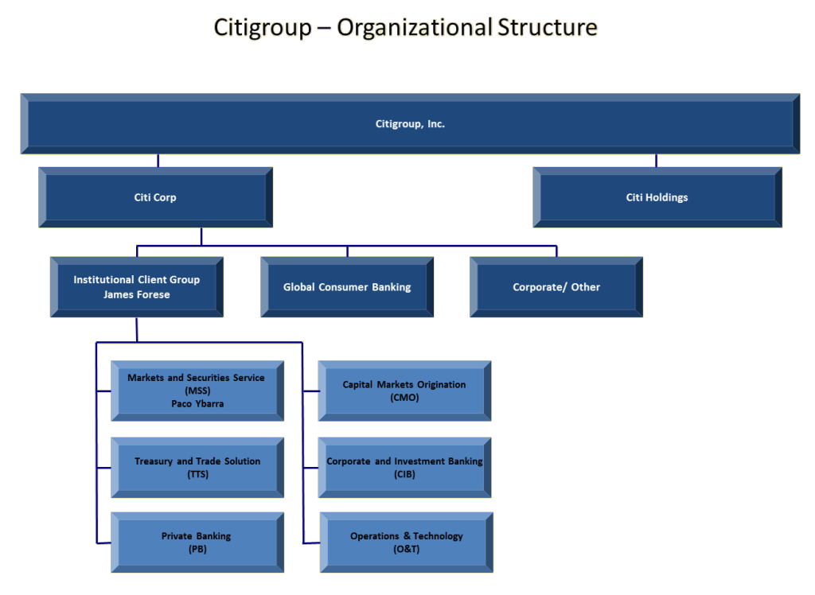

Slide 3
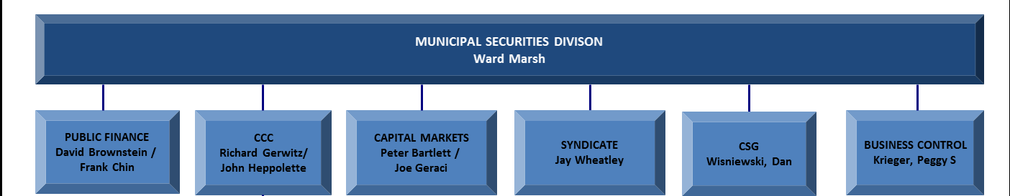
CCC : Citi Community Capital

Slide 4
CCC: Citi Community Capital
The community lending and investing group of Citi
Offers the industry’s most comprehensive affordable housing and community development financial products.
From single project transaction to portfolio wide solutions.
Combines community development expertise with capital markets capabilities to offer financial solutions that build stronger communities.

Slide 5
DealTrax
In CCC, bankers use an application called DealTrax for making deals.
Helps in various stage of deals: from initial proposal to final lending.

Slide 6
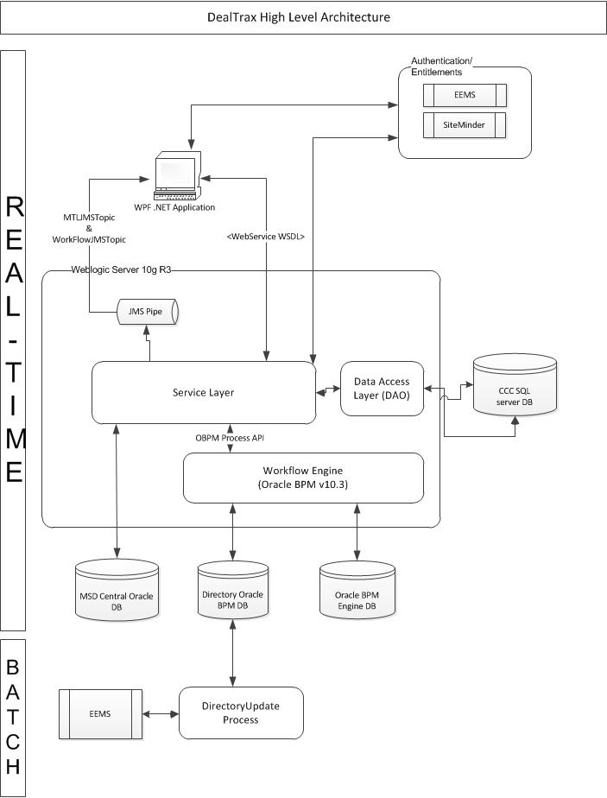
DealTrax Current Architecture

Slide 7
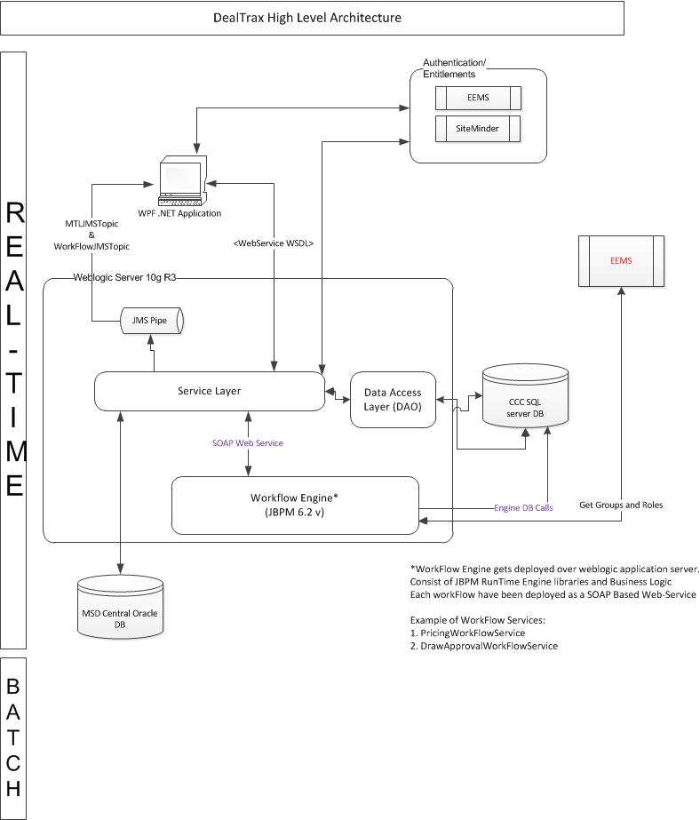
DealTrax New Architecture

Slide 8
JBPM
An Open Source BPM System

Slide 9
About
BPM is a flexible Business Process Management (BPM) System.
Allows you to model your business goals by describing the steps that need to be executed, using a flow chart.

Slide 10
Advantages
Open source, light-weight, extensible Workflow engine written in pure Java.
Supports latest BPMN 2.0 specification.

Slide 11
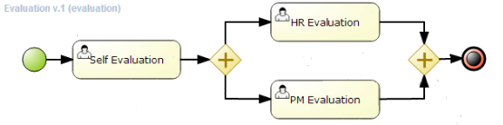
A sample BPMN process

Slide 12
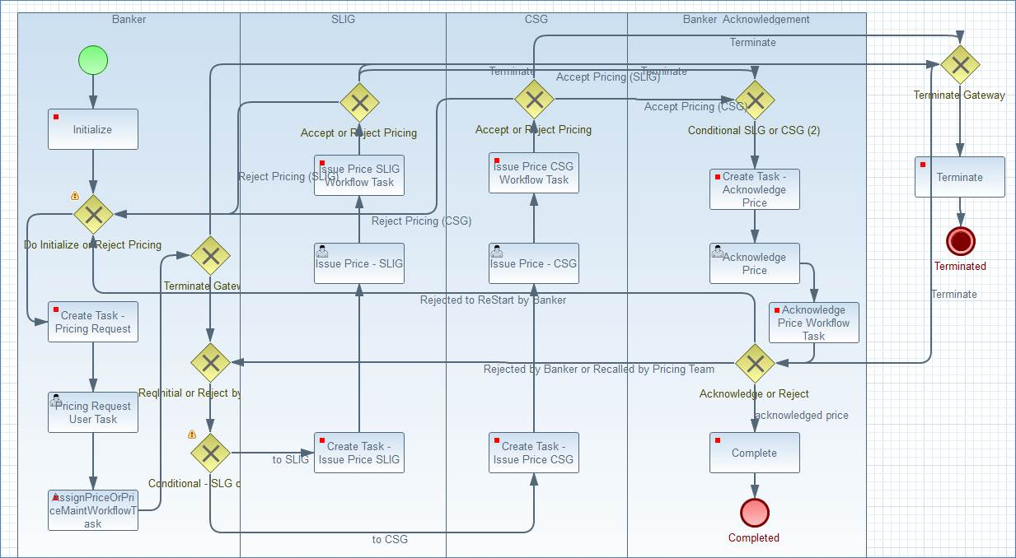
An example of DealTrax Workflow

Slide 13
JBPM is being used to replace OBPM in Dealtrax Application used by Municipals team.
The Workflows, initially in OBPM are being re-written in JBPM
This offers
cost benefit as the JBPM is open source application
extensive features.

Slide 14
Issue :

Slide 15
Need a console to monitor various running instances.
Should help in identifying stalled processes.
To identify the state of any process instance.
To identify which user group has most pending tasks.

Slide 16
Solutions :

Slide 17
KIE Console
Can only work with Git based repositories.
Can only monitor Workflows deployed using it.
Limitations in deploying WARs (Web Application Archives).
Limited support for Weblogic server deployment .

Slide 18
Develop a Custom Console
Will fulfill our immediate needs.
Can be easily extended to support our future needs.
Would be compliant with different architectures thus, can be used across teams.

Slide 19
Problem Description
Build a console to manage and monitor the JBPM Instances.

Slide 20





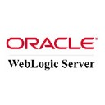


Google Web Toolkit | Java | Bootstrap | jBPM
HTML / CSS | Weblogic | Sonarqube

Slide 21
Application Developed :

Slide 22
JBPM Dashboard
Features :
Shows all the processes running on the server.
Can select any particular instance of a process.
View
status of the instance
who it is assigned to
start and stop dates. etc.
See the values associated with a process.
Terminate a stalled process.

Slide 23
Process Definitions
List of all the unique Workflows running on the system

Slide 24
First screen of the Dashboard
Shows the count of running instances of each process.
Displays a graphical representation of the same.

Slide 25
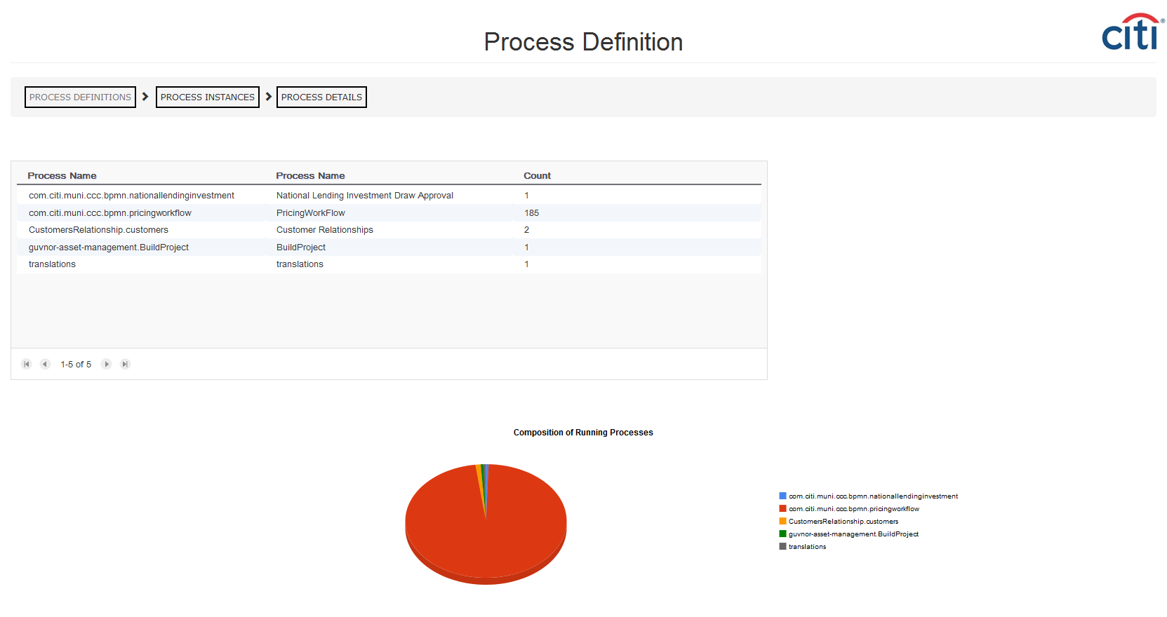

Slide 26
Process Instances
List of all the Instances for selected Workflow

Slide 27
Second screen of the Dashboard
Various filters to let you quickly select required
Gives an overview regarding various instances of that process

Slide 28
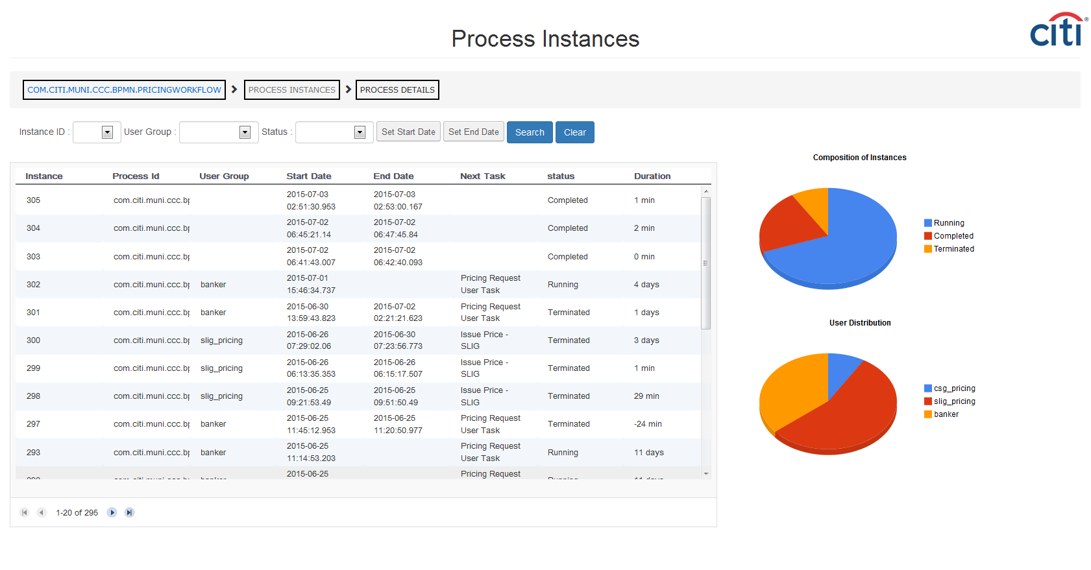

Slide 29
Instance Details
Details about the selected Instance

Slide 30
Third Screen of the Dashboard
Shows various Tasks which were executed while process instance was running.
The values which were set for variables while instance was running.
An option to terminate an instance (ex. if it is stalled).

Slide 31
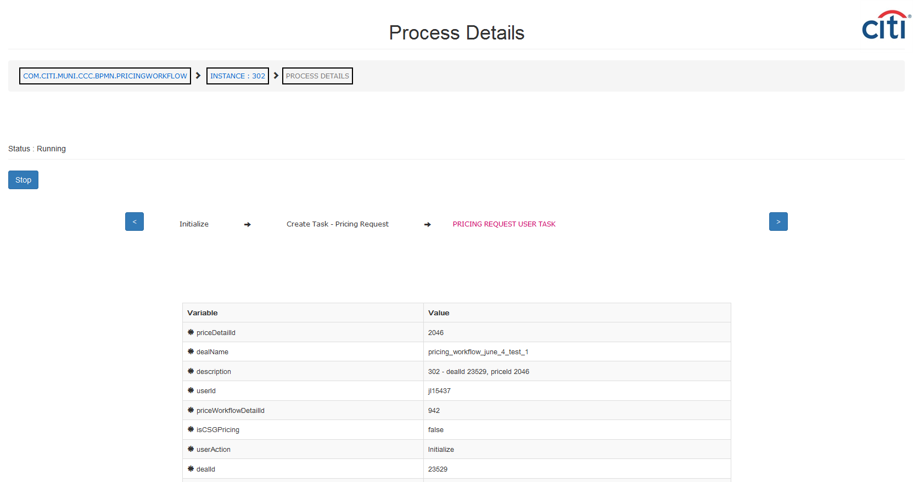

Slide 32
Configurable
Configuration File to make Dashboard generic

Slide 33
Following Configurations are possible :
Choice of Database.
Option to include a column from front end application.

Slide 34
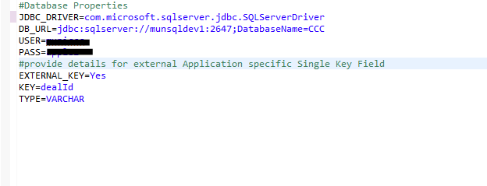

Slide 35
DEMO

Slide 36
Results
A generic Dashboard for monitoring and managing JBPM Workflows.
Ability to link to columns from GUI for enhanced management.
Minimal dependencies and configurations to make deployment very fast and simple.

Slide 37
The JBPM Console was presented to :
Global DealTrax Technology Team
CitiVelocity Research Team
and their valuable suggestions were accommodated.

Slide 38
Quality of Code

Slide 39
SonarQube Evaluation
Low Technical Debt : 2.0 %
SQALE Rating : A
Blocker Issues : 0
Critical Issues : 0

Slide 40
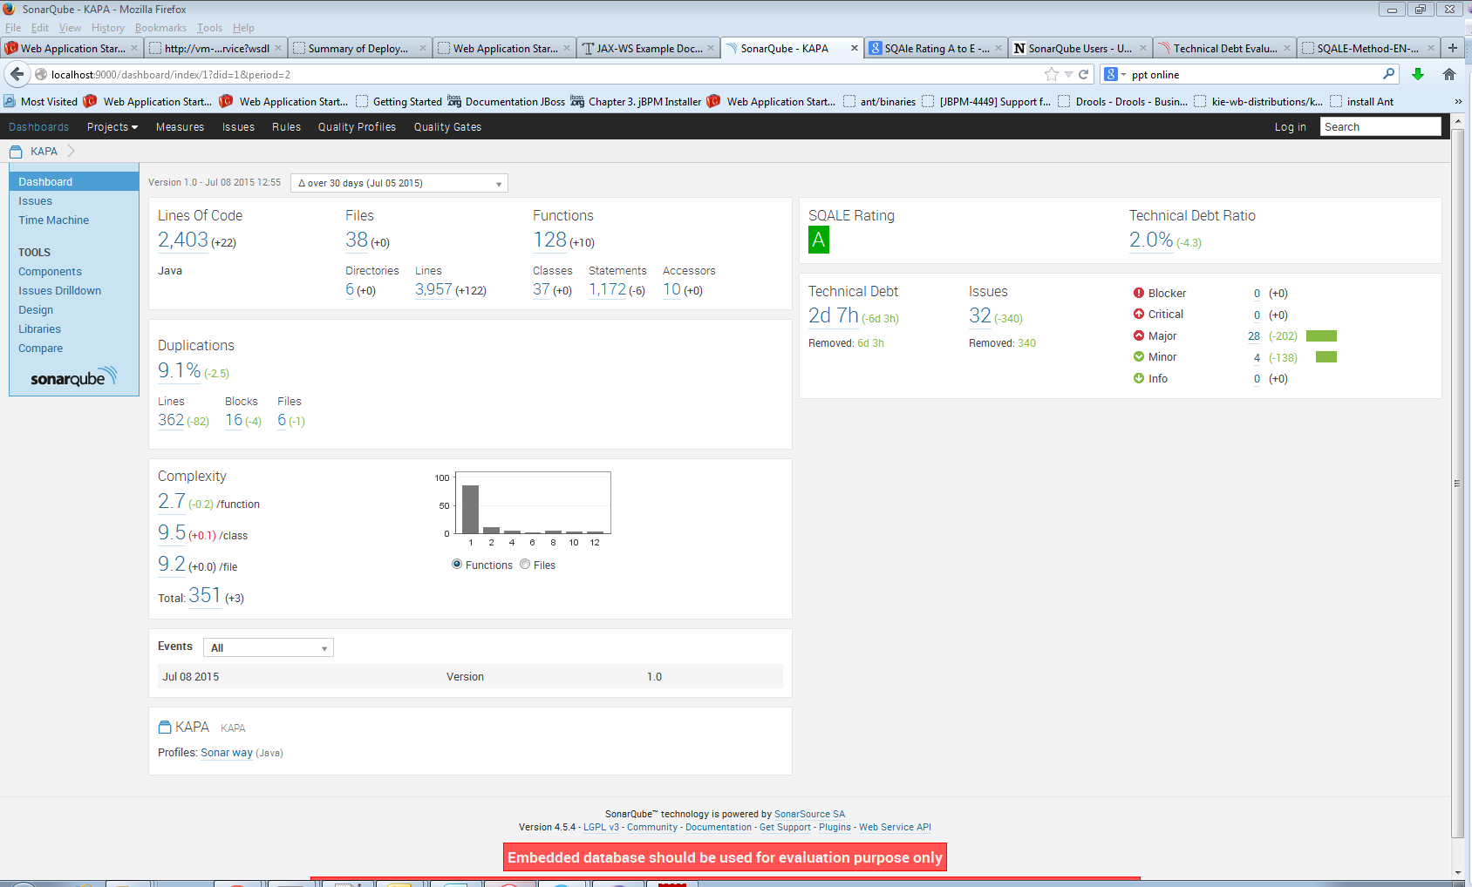

Slide 41
Possible Extensions
More JBPM API Calls can be added as per need.
Any existing web service can be consumed.
For Example :
Start Service
Delegate Task etc.
Integration with SSO.

Slide 42
Learning Outcome
Professional
Understanding different phases of SDLC like requirements, designing, coding, testing, deployment for real world applications.
Exposure to diverse technology and tools.
Interaction with some very talented and experienced Developers
Personal
Getting an insight into the norms and conventions of a huge corporation like CITI.
Values of teamwork and synergy.
Working and interacting with veterans provided immense learning opportunities.

Slide 43
Thank You !

